Slide 1
Forecasting Infectious Disease
Slides: http://bit.ly/2CEdBpU
Steven Riley s.riley@imperial.ac.uk
Caroline Walters c.walters@imperial.ac.uk
Haowei (Vivi) Wang haowei.wang@imperial.ac.uk
Ada Yan a.yan@imperial.ac.uk

Slide 2
OVERALL OBJECTIVES
* Understand the objectives of forecasting
* Understand how accuracy in forecasting is assessed
* Be able to use a linear model to make a forecast (appropriate R code provided)
* Be able to use a simple mechanistic model to make a forecast (appropriate R code provided)
* Be able to use a historical null model as a benchmark

Slide 3
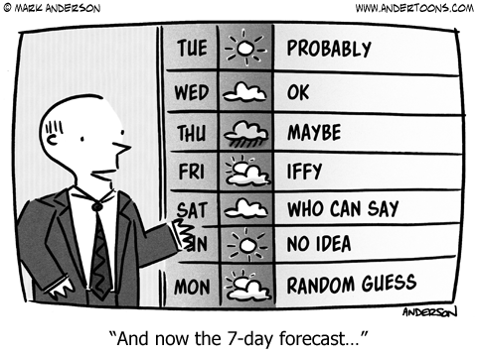
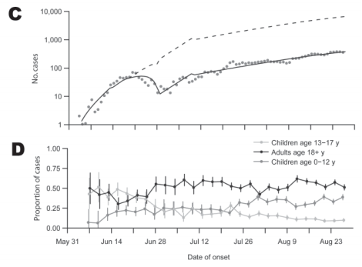
What is forecasting?
Wu et al, EID 2010
Notes:
Nowcasting

Slide 4
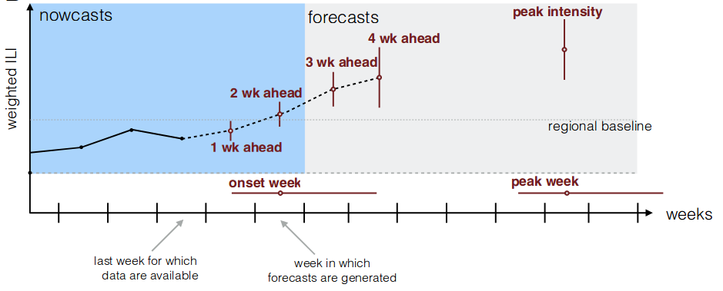
Inputs and prediction targets
Incidence data time series (aggregated or by age, location, …)
Data on vectors (for vector-borne diseases)
Contact data
Mobility data
Climate data
Social media/internet searches
Incidence data from previous outbreaks
Reich et al. (2019) PNAS

Slide 5
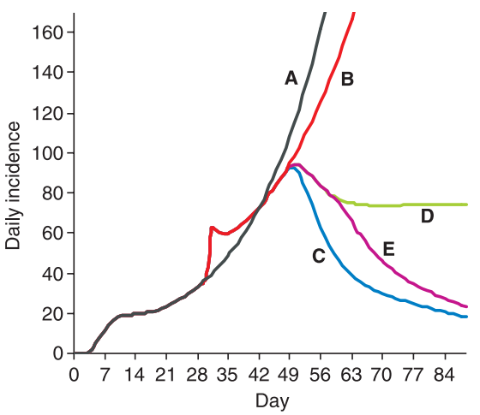
Public health implications of predictions
Predicted incidence →
Public health burden e.g. hospital beds required, number of doctors required at each location, amount of antivirals/vaccines required
Economic burden e.g. number of work days missed, loss of GDP
The effects of interventions e.g. social isolation, contact tracing, pharmaceutical treatments
A No intervention
B Faster onset to admission
C Faster onset and movement restriction
D Faster onset plus 50% reduced contact (Rt=1)
E Faster onset plus 70% reduced contact
Riley et al, Science, 2003
Notes:
Interventions

Slide 6
Differences between model fitting and forecasting
Forecasting involves fitting a model to data, but with the specific objective of prediction
Other reasons to fit a model to data: to understand the mechanisms of transmission, to estimate key quantities e.g. the incubation period…
When wanting to understand mechanisms, parsimony i.e. having the simplest model that explains the data is a consideration
For prediction, accuracy is the only important thing -- parsimony not important
Notes:
Accuracy 1, parsimony 0. Don’t want parameter estimates, wnat estimates of actual things. Mechanism less important

Slide 7
Retrospective vs. prospective forecasting
Retrospective forecasting
  used to develop forecasting methods and select between them
  pretend we don’t know what the historical data is → reveal data bit by bit → forecast → assess accuracy
Prospective forecasting
  used to do a forecast with the available data now -- don’t know real answer
  requires commitment to a single method and single prediction at a time

Slide 8
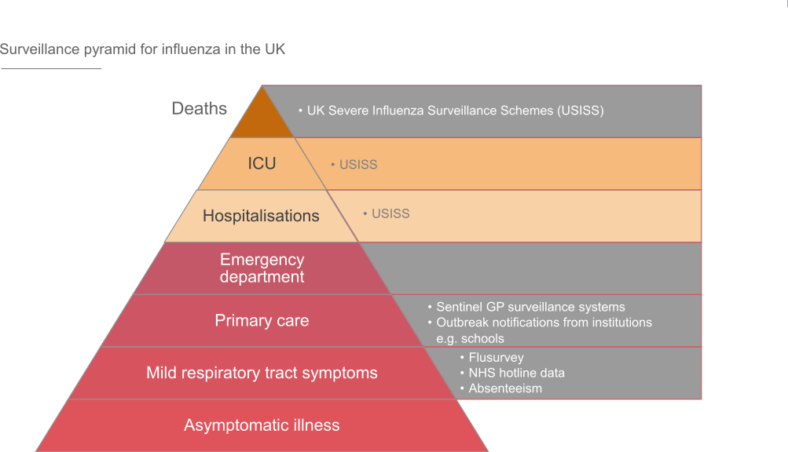
Different types of incidence data: influenza
Adapted from slide by Allen Cheng (https://mvec.mcri.edu.au/wp-content/uploads/2018/07/Influenza_Prof.-Allen-Cheng.pdf)

Slide 9
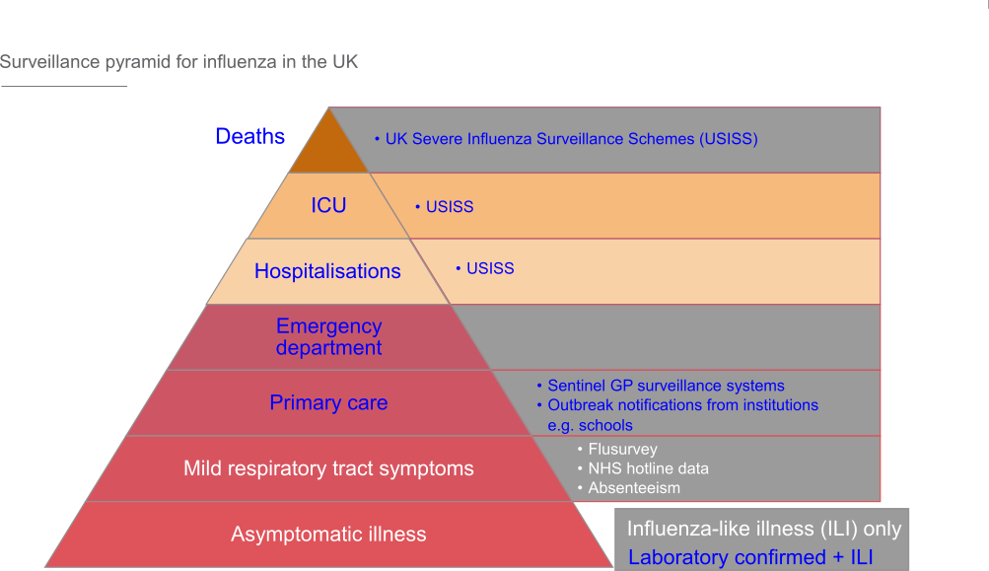
Different types of incidence data: influenza
Adapted from slide by Allen Cheng (https://mvec.mcri.edu.au/wp-content/uploads/2018/07/Influenza_Prof.-Allen-Cheng.pdf)

Slide 10
Different types of incidence data: influenza
 | Laboratory-confirmed | Influenza-like illness
Pros | Definitely influenza May know strain | Large sample size Faster reporting Covers milder cases
Cons | Delays in processing Small sample size Sampling bias towards severe cases | Might be a different respiratory illness Don’t know strain
Adapted from slide by Allen Cheng (https://mvec.mcri.edu.au/wp-content/uploads/2018/07/Influenza_Prof.-Allen-Cheng.pdf)

Slide 11
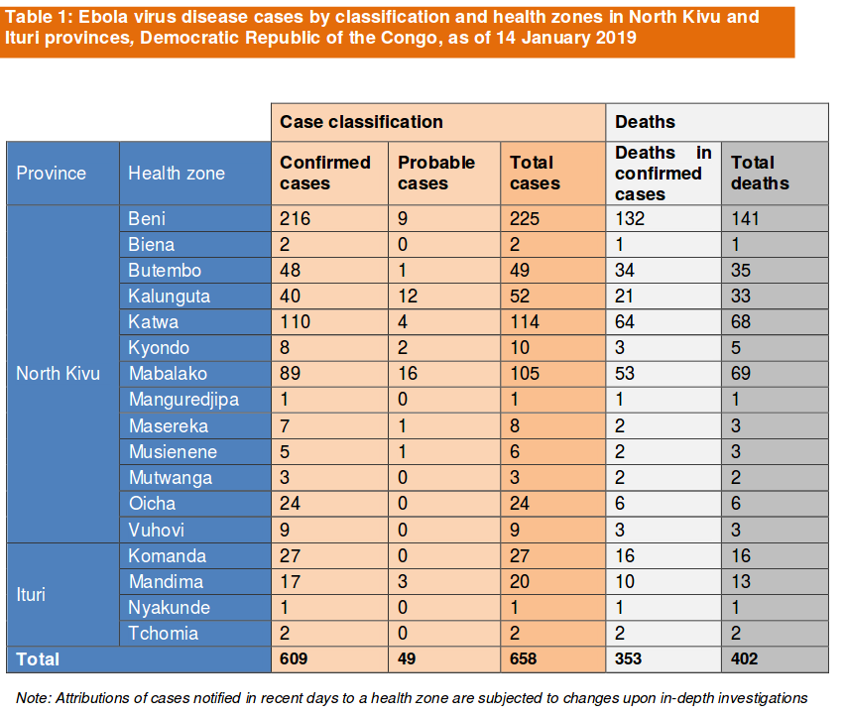
Different types of incidence data: Ebola
https://www.who.int/ebola/situation-reports/drc-2018/en/

Slide 12
Practical Part 1
In RStudio, run devtools::install_github("c97sr/learnidd", build_opts = c("--no-manual"), force = TRUE)
  browseVignettes("learnidd")
  Click on forecasting (HTML)
  (Solutions are forecasting_ans)
  Backup link: http://bit.ly/2FF41qR

Slide 13
What methods do we use? (more in practical)
Statistical models | Mechanistic models
Phenomenological Can formulate model from data without knowing how transmission works Cannot predict changes in incidence due to depletion of susceptibles/pharmaceutical interventions/behavioural interventions/organic changes in behaviour Examples: generalised linear model, time series analysis | Incorporate infection dynamics Need prior knowledge of how transmission works Can predict changes in incidence due to depletion of susceptibles/pharmaceutical interventions/behavioural interventions/organic changes in behaviour Examples: compartmental models, network models
Others: Combination e.g. SEIR model with changing R_0 Human intervention (from crowdsourcing to selecting from forecasts from different models)
Notes:
Broadly, statistical vs mechanistic (lots covered in practical). Pros and cons
Historical data: can be directly used in statistical, used to inform priors in mechanistic

Slide 14
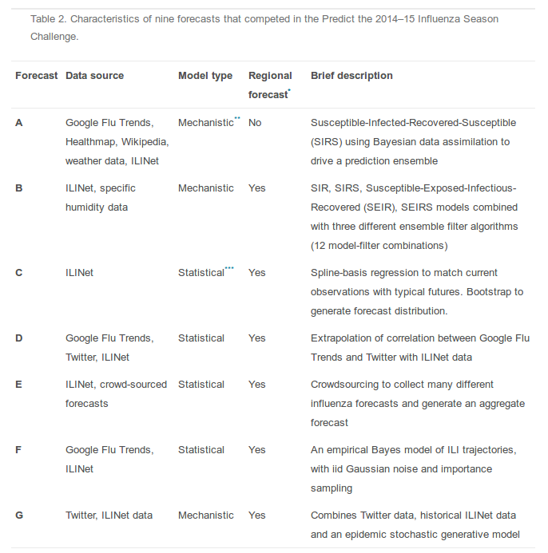
What methods do we use? (more in practical)
Notes:
Broadly, statistical vs mechanistic (lots covered in practical). Pros and cons
Historical data: can be directly used in statistical, used to inform priors in mechanistic

Slide 15
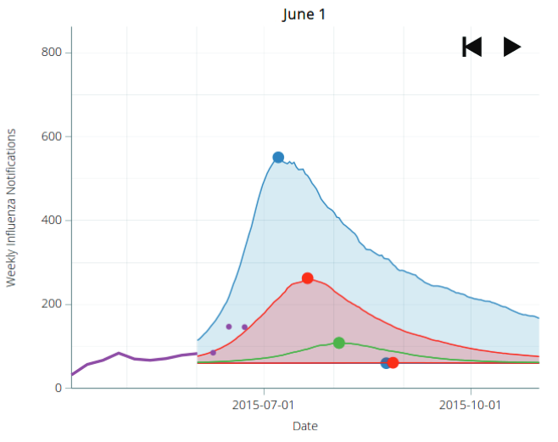
How do we report forecasts?
Point estimate?
Confidence interval?
Probability density function?
Peak
90% CI
50% CI
Data
Median
Moss et al. (2018) Australian and New Zealand Journal of Public Health
Notes:
Metrics in previous studies e.g. CDC

Slide 16
Practical part 2: up to Qu. 2.3

Slide 17
How do we choose which incidence timepoints to use?
Do we use all available incidence data? A few data points closest to the current time? Do we trust recent data points?
Some timepoints might not be well captured by the model → ignore
Notes:
How far behind -- how far forward? (see practical)

Slide 18
How do we assess accuracy?
Point estimate:
  was it within a given range of the observed value?
  absolute error, root mean squared error etc. (RAPIDD Ebola Forecasting Challenge, Viboud et al. (2018), Epidemics)
Time series of point estimates:
  combine accuracy metrics from point estimates
  bias e.g. fitting a linear regression to predicted and observed incidences (RAPIDD Ebola Forecasting Challenge)
Probability distribution:
  how much of the probability distribution was within a given range of the observed value? (CDC Influenza Forecasting Challenge)
RAPIDD Ebola Forecasting Challenge: Viboud et al. (2018), Epidemics
CDC Influenza Forecasting Challenge: Biggerstaff et al. (2018), Epidemics
Notes:
Metrics in previous studies e.g. CDC

Slide 19
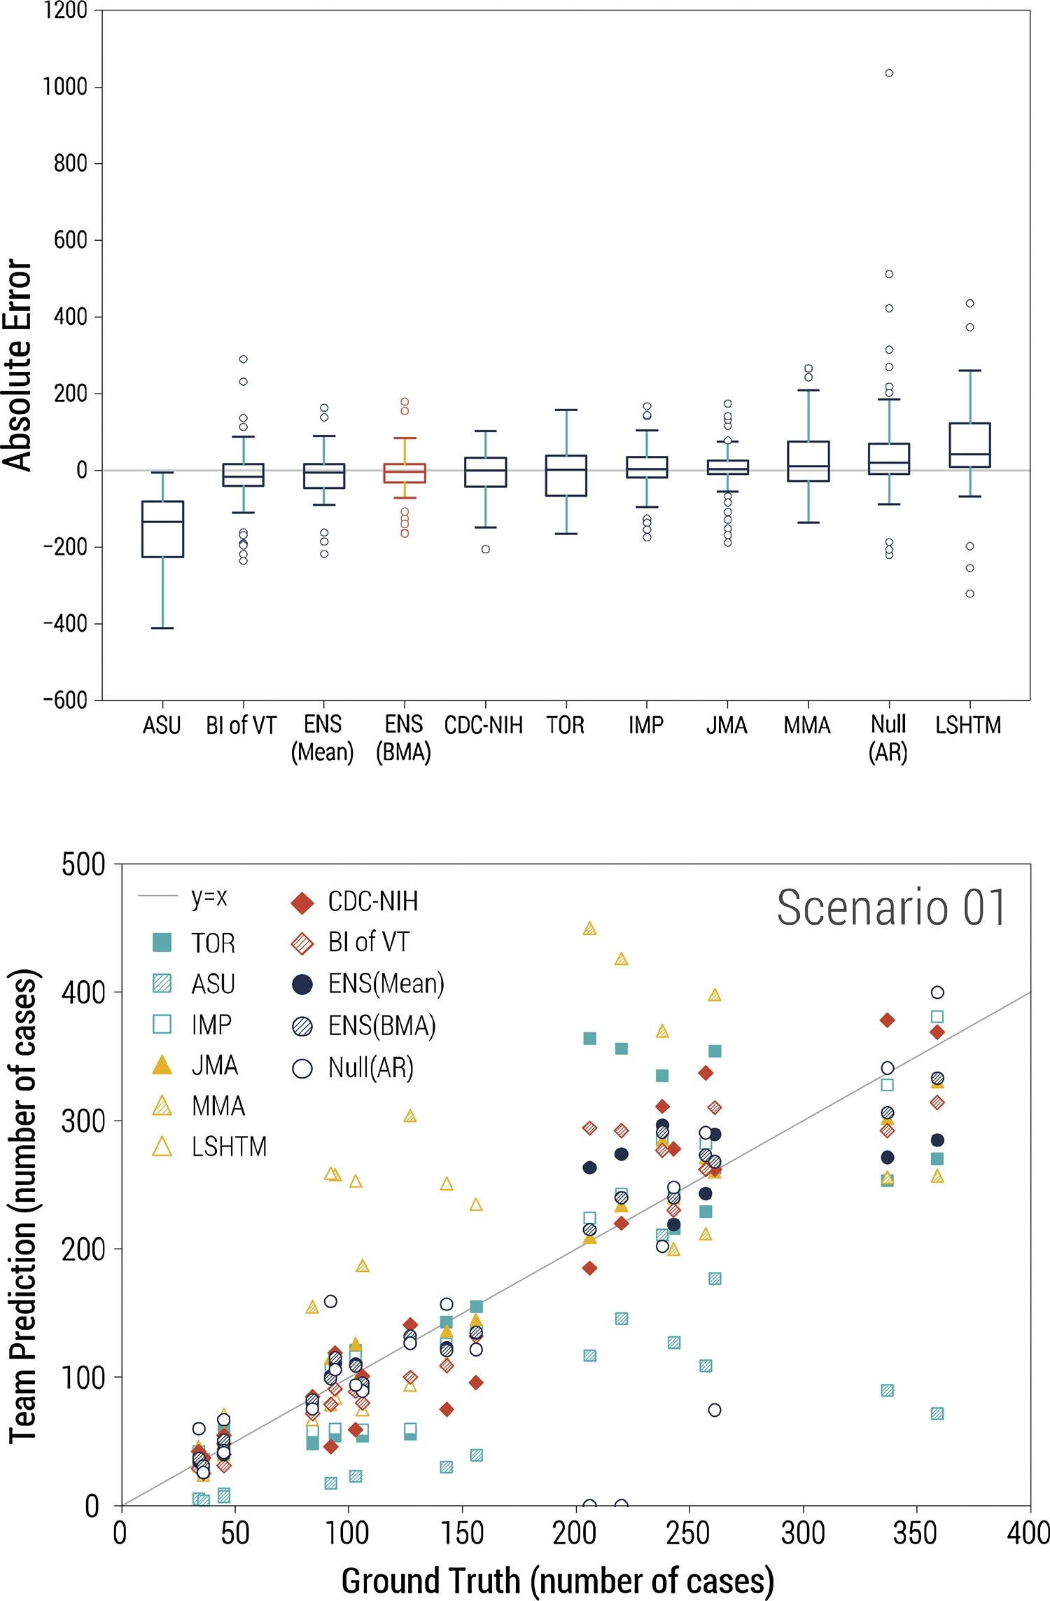
How do we assess accuracy?
Fig. 2. Performance statistics for incidence forecasts, displaying data for all prediction time points. Left: Box plots of the mean absolute error by team, across all scenarios. Red indicates the Bayesian ensemble mean (smallest absolute error). Right: Agreement between synthetic and predicted incidences by team for data-rich scenario 1.
RAPIDD Ebola Forecasting Challenge: Viboud et al. (2018), Epidemics
Notes:
Metrics in previous studies e.g. CDC

Slide 20
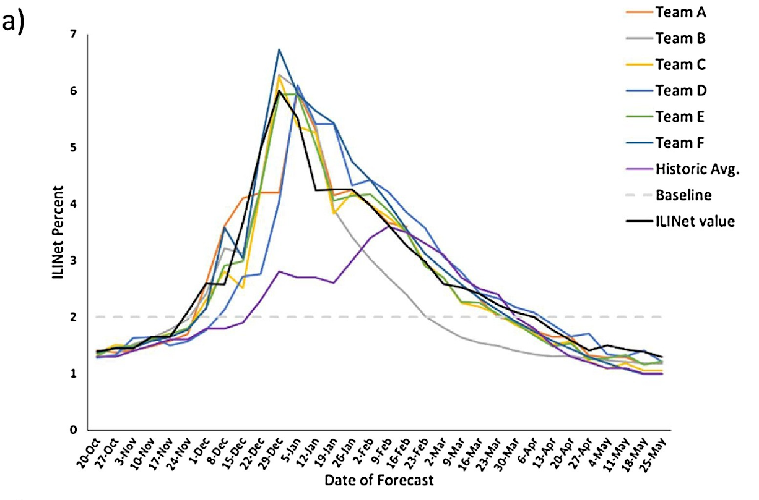
How do we assess accuracy for a seasonal forecast? Against a historic average
Fig. 3a. 1-week- ahead point forecasts for the percent of visits due to influenza-like illness reported through the U.S. Outpatient Influenza-like Illness Surveillance Network (ILINet) and the actual ILINet value (in black).
CDC Influenza Forecasting Challenge: Biggerstaff et al. (2018), Epidemics
Notes:
Metrics in previous studies e.g. CDC

Slide 21
Practical part 2.4

Slide 22
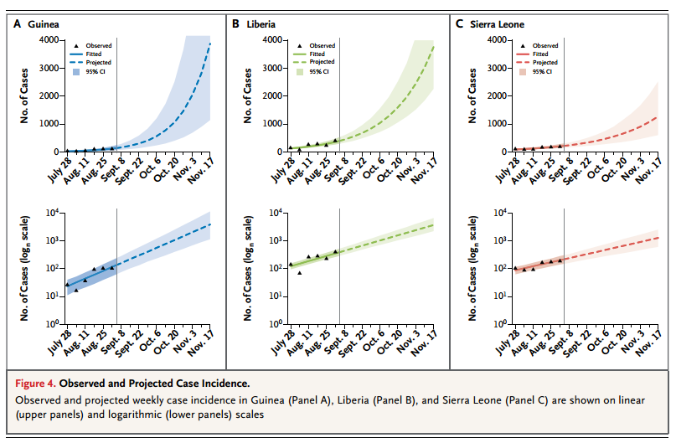
Practical part 3
WHO Ebola Response Team, NEJM, 2013

Slide 23
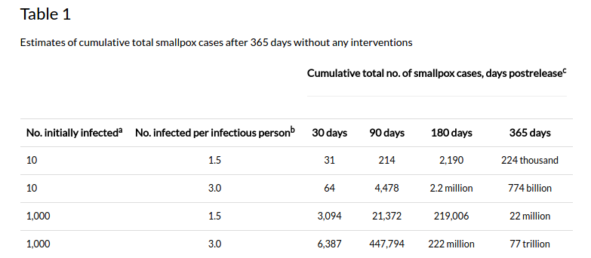
LINEAR MODELS DON’T PREDICT THE PEAK
Meltzer et al, EID, 2001

Slide 24
What methods do we use? (more in practical)
Statistical models | Mechanistic models
Phenomenological Can formulate model from data without knowing how transmission works Cannot predict changes in incidence due to depletion of susceptibles/pharmaceutical interventions/behavioural interventions/organic changes in behaviour Examples: generalised linear model, time series analysis | Incorporate infection dynamics Need prior knowledge of how transmission works Can predict changes in incidence due to depletion of susceptibles/pharmaceutical interventions/behavioural interventions/organic changes in behaviour Examples: compartmental models, network models
Others: Combination e.g. SEIR model with changing R_0 Human intervention (from crowdsourcing to selecting from forecasts from different models)
Notes:
Broadly, statistical vs mechanistic (lots covered in practical). Pros and cons
Historical data: can be directly used in statistical, used to inform priors in mechanistic

Slide 25
Practical part 4

Slide 26
Web resources
https://www.reconlearn.org/post/simulated-evd-early.html outbreak simulation using R packages
https://predict.cdc.gov/ CDC flu forecasting competition

